Slide 1
WHERE WILL DEMAND FOR LAND COME FROM? EVIDENCE FROM FARM MODELS
Oleg Nivievskyi (Kyiv School of Economics), oniviev@gmail.com
Heinz Strubenhoff, IFC/World Bank Group
World Bank Conference “Land and Poverty”
Washington, 22 March 2017

Slide 2
Why is it important to know the potential demand
Farmland moratorium is for more than 15 years
It will be lifted soon, presumably from 2018
Who will be able to buy the farmland?
What will be the potential demand for farmland?
What will be the potential credit demand?

Slide 3
Potential demand estimation results using:
Farm surveys (USAID Agroinvest Project 2015 survey);
  RESULT: 82 354 ha; small and medium-size farms dominate
Population of Farms in Ukraine for 2013-2015 period, using farm-level input-output/costs and revenues data
  RESULT: 258 040 ha to 1 681 307 ha
  RESULTS IN PERSPECTIVE: total agricultural land in Ukraine is about 42 mln ha

Slide 4
Evidence from 2015 Agroinvest Farm Survey
Willingness to buy in the first 2 years after moratorium: 6.65% of peasant farms and 5.74% of corporate agricultural enterprises
Average reported farmland plot to buy: 33 ha – peasant farms; 125 ha – corporate agricultural enterprises
Estimated farmland demand: 82 354 ha
Problem:
  we don’t know about financial capacity of the farms that expressed their willingness to buy farmland
  great majority of agricultural producers (74.67% of peasant farmers and 67.29% of agricultural enterprises) did not give an answer at all

Slide 5
Evidence from Farm-level Performance Data
Estimation in two stages:
  Calculate farm-level 2013-15 average gross margins (=revenues – variable costs)
  Calculate farmland values from current rental prices (using capitalization formula)
  Identify those farms with gross margins sufficient to finance mortgage loans
Assumptions for farmland values estimation
  Capitalization rate: 5.07% = 6.04% (Gov’t bonds in usd) – 0.97% (Avg Total Factor Productivity grows for 20 years)
  Down payment is 65% (NBU requirements: liquidity coefficient of land is 0.35)

Slide 6
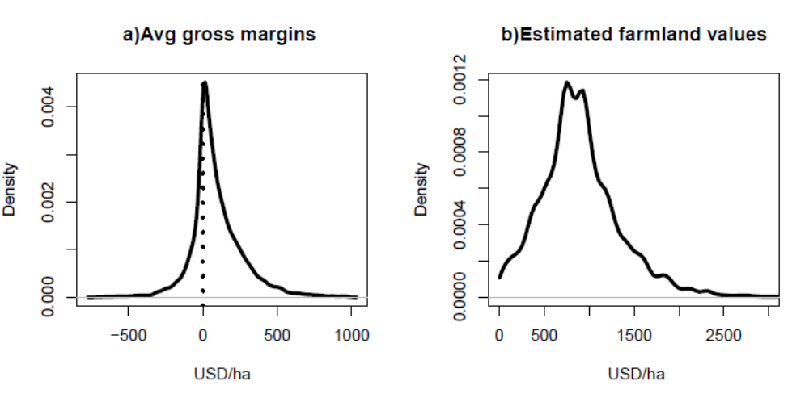
Evidence from Farm-level Performance Data

Slide 7
Evidence from Farm-level Performance Data
RESULTS:
  4.9% of peasant farms and corporate agricultural producers have sufficiently good performance to finance farmland mortgage loans (without subsidies)
  Farmland demand with 200 ha ceiling assumption: 258 040 ha:
    < 60 ha: 6.35% (or 16 397 ha)
    60÷260 ha: 24.68% (or 63 680 ha)
    260÷667 ha: 25.31% (or 65 322 ha)
    667÷1581 ha: 21.71% (or 56 041 ha)
    > 1581 ha: 21.93% (or 56 600 ha)
  Farmland demand without 200 ha ceiling: 1 681 307 ha

Slide 8
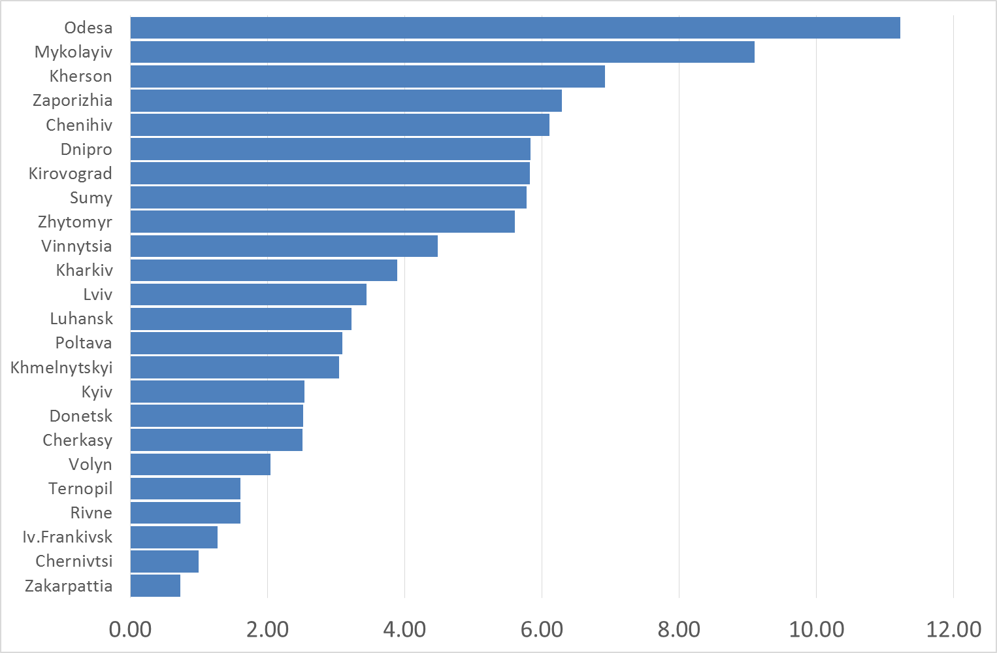
Geographical Profile of Farmland Demand, % of total expected demand

Slide 9
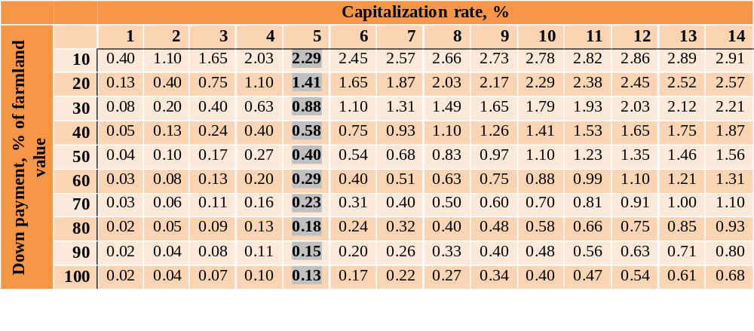
Farmland Demand: sensitivity analysis, in million ha
Without a recourse to commercial loans Farmland Demand is 132 857 ha!!!

Slide 10
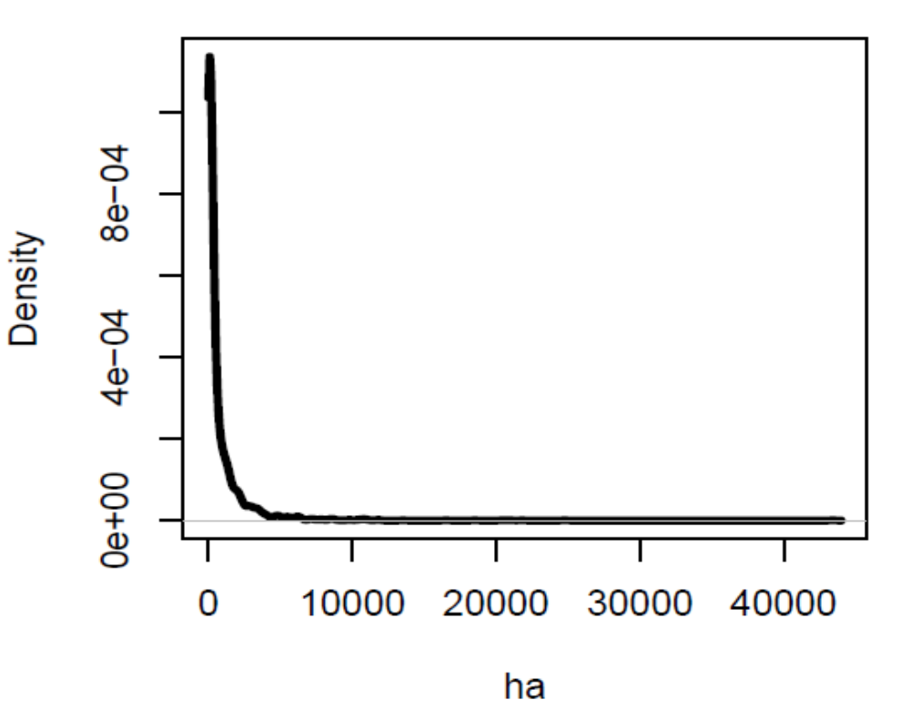
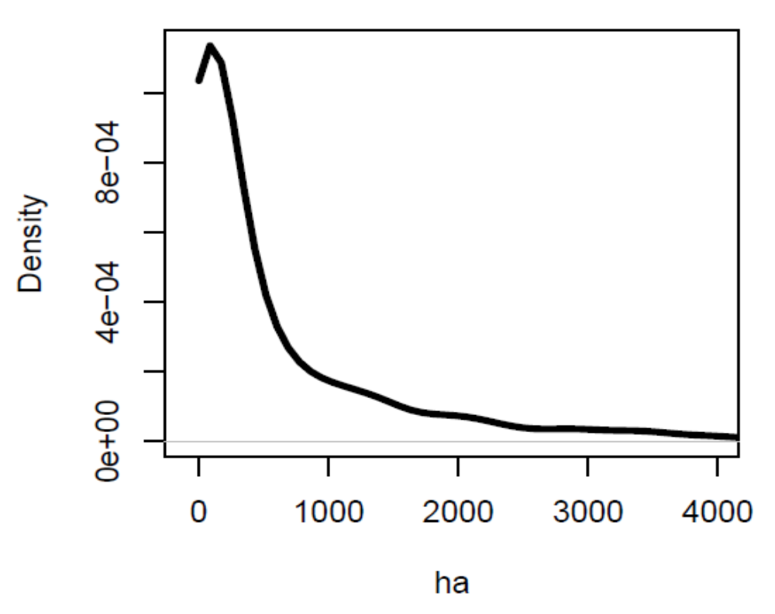
Farmland demand is expected to come from various farm sizes, especially from small and medium ones
Figure 1: Size profile of ‘bankable’ farms
Figure 2: Zoomed in version of Figure 1

Slide 11
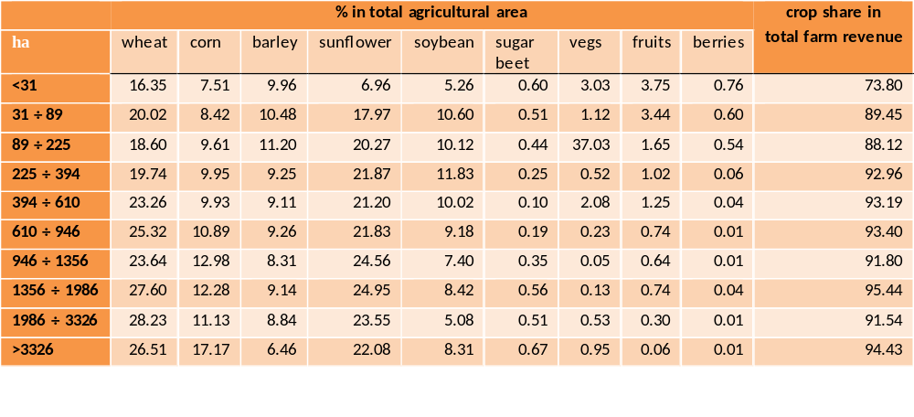
Farm Models Profiles of Farms that are Able to Finance Farmland Loans

Slide 12
Concluding remarks and implications
FARMLAND DEMAND (annual)
  With use of farmland loans: 258 000 ha
  Without a recourse to farmland loans: 134 000 ha
  Small and medium farms dominate
  Southern regions dominate
  No drastic differences btw farm models
POTENTIAL DEMAND FOR FINANCIAL RESOURCES
  USD 92 million

