Slide 1
Factor Misallocation, Entry and Exit, and Agricultural Productivity in Ukraine
Klaus Deininger World Bank | Denys Nizalov University of Kent/Kyiv School of Economics
Mykola Ryzhenkov Kyiv School of Economics | Sudhir K Singh World Bank
Land and Poverty Conference 2017
Washington DC
March 20-24, 2017

Slide 2
Introduction
One of the central topics in modern development economics is resource misallocation in various sectors of economy and its impact on productivity.
Misallocation accounts for major portion of differences in income and productivity across countries.
There is little known about resource misallocation in agriculture and its impact on agricultural productivity due to lack of quality data in the sector.
Ukraine provides a unique institutional setting as compared to other European countries.
It is one of the few countries where farm size are relatively large and that have seen rapid expansion of large farms over the last decade.
Since December 2001 sales and conversion of over 96% of agricultural land in Ukraine are banned by the Moratorium.

Slide 3
Literature
Restuccia and Rogerson (2008) and Hsieh and Klenow (2009): idiosyncratic distortions affect allocation of resources across establishments and total factor productivity.
A huge number of studies of manufacturing. Some examples, Hsieh and Klenow (2009) – China, India, USA; Oberfield (2013) and Chen and Irarrazabal (2015) – Chile; Bellone and Mallen-Pisano (2013) – France; Dias et al. (2016) – Portugal; Ryzhenkov (2016) – Ukraine
In opposite to manufacturing, a few studies exist on the impact of resource misallocation on productivity in agriculture.
Adamopoulos and Restuccia (2014) – agriculture in poorer countries is less productive than nonagriculture when compared to rich countries, a larger fraction of allocated to agriculture than in rich countries.
Restuccia and Santaeulalia-Llopis (2017) - agriculture is important in accounting for productivity differences between poor and rich counties, a bulk of productivity losses due to factor misallocation are directly associated with restricted land markets

Slide 4
Literature
Gollin et al. (2014) explain cross-country differences in agricultural productivity with three hypotheses:
  policy-driven land misallocation
  farmers in poor countries do not use productivity-enhancing inputs
  agriculture in poor countries employ the lowest-ability labor.
Results on agriculture:
  Restuccia and Santaeulalia-Llopis (2017) – 3.6 fold gains for Malawi
  Adamopoulous et al. (2017) - 84% gains for China.
  Dias et al. (2016) - 17.0-31.3% for Portugal
Results on Ukraine in manufacturing sector:
  Ryzhenkov (2016) - 146-249% for Ukrainian manufacturing

Slide 5
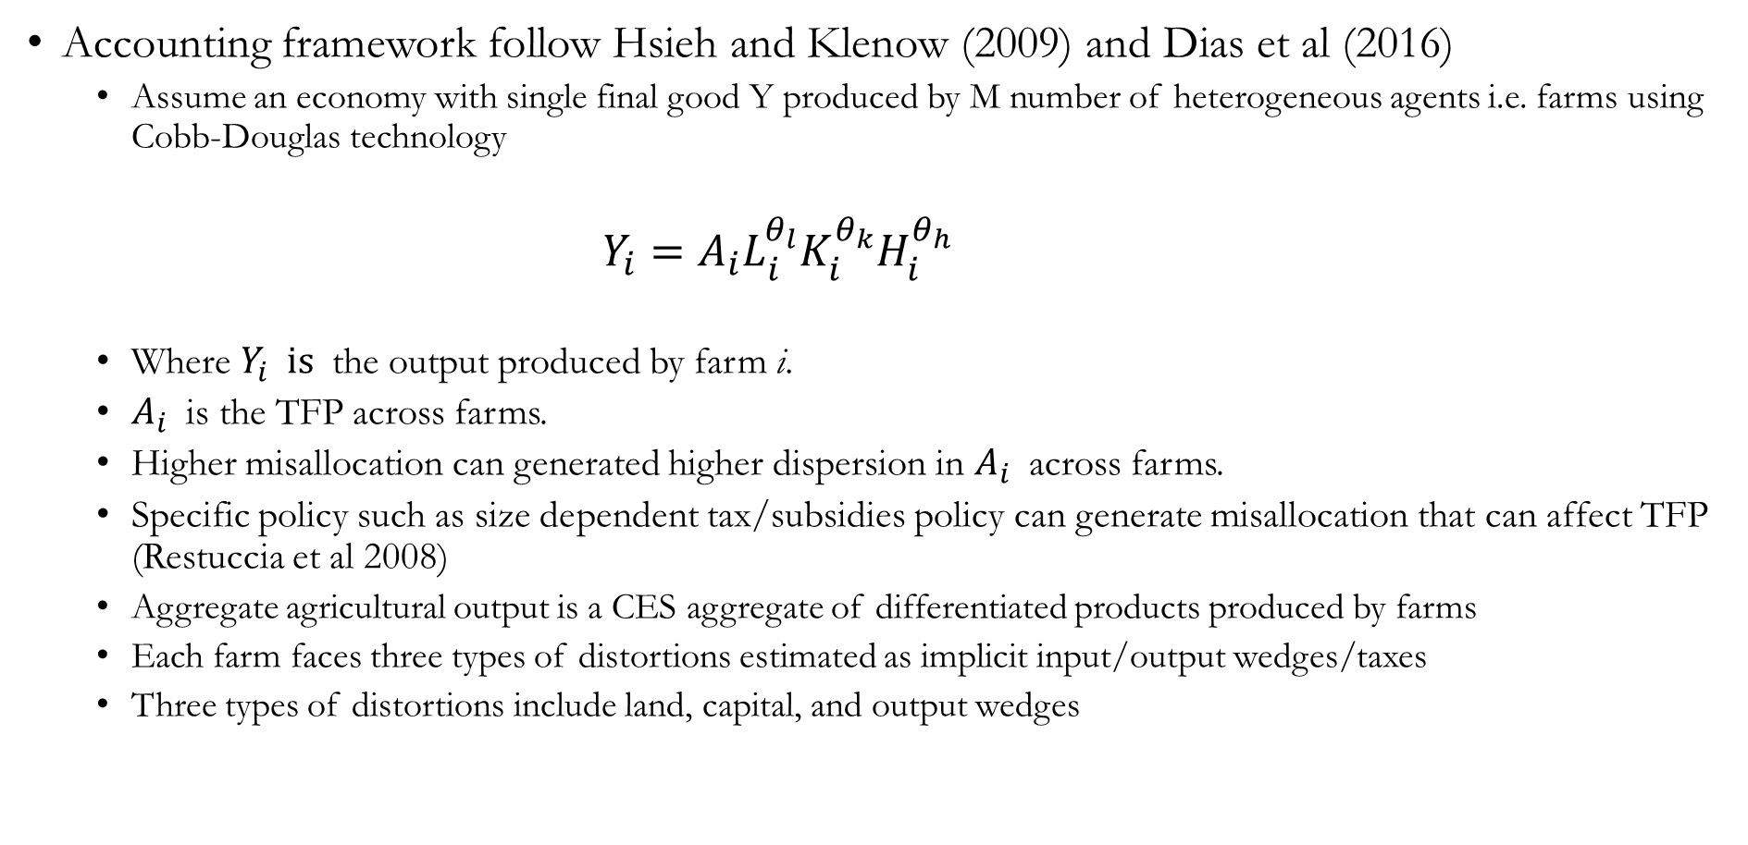
Methodology
Accounting framework follow Hsieh and Klenow (2009) and Dias et al (2016)
  Assume an economy with single final good Y produced by M number of heterogeneous agents i.e. farms using Cobb-Douglas technology
  $Y_{i}=A_{i}L_{i}^{θ_{l}}K_{i}^{θ_{k}}H_{i}^{θ_{h}}$
  Where $Y_{i} is$ the output produced by farm i.
  $A_{i}$ is the TFP across farms.
  Higher misallocation can generated higher dispersion in $A_{i}$ across farms.
  Specific policy such as size dependent tax/subsidies policy can generate misallocation that can affect TFP (Restuccia et al 2008)
  Aggregate agricultural output is a CES aggregate of differentiated products produced by farms
  Each farm faces three types of distortions estimated as implicit input/output wedges/taxes
  Three types of distortions include land, capital, and output wedges

Slide 6
Data
Source:
  Very rich panel data on commercial farm from Ukraine collected by Ukraine’s State Statistics Committee
  Statistical form 50-SG “Report on main economic indicators of performance of agricultural enterprises”
Construction of a database:
  The universe of the about 10,000 large commercial farms in the country
  These farms cultivate about 89 percent of commercially farmed land
  Sample is restricted to crop producers with physical output valued at median prices for each rayon
  Farms above 200 ha are required to report
  Wage bill and physical units of a labor is reported in the data
  Dataset also contains arable area and rental payments for land
  Physical output is reported by crops and farm, monetary value of sales and quantity sold are also reported
  Value added is calculated in a standard way by subtracting the intermediate inputs from output values
Some challenges in data:
  A commercial farm can operate on multiple parcels known as branches.
  No information on capital stock in the data, we have information on capital depreciation for each farm by years

Slide 7
Data
 | All | Median | 10th Percentile | 90th Percentile
TFP | 1.975 | 1.454 | 0.04 | 7.127
Total output ('0000') | 812.8 | 929.77 | 319.19 | 1061.13
Output per ha | 3343.26 | 3408.71 | 1391.66 | 6403.58
Land | 2157.02 | 2310.5 | 1878.19 | 1691.03
Median land | 1480 | 1651 | 1140 | 1181.5
Max. land | 2829.09 | 2966.21 | 2600.9 | 2417.59
Share of leased land | 0.8 | 0.81 | 0.72 | 0.88
Profit per ha | 443.37 | 515.32 | -1944.98 | 2870.4
Cost per ha | 2900 | 2893.39 | 3336.52 | 3533.18
Capital per ha | 362.22 | 381.15 | 451.38 | 332.58
Labor per ha | 383.24 | 381.96 | 455.92 | 408.75
Intermediate Inputs per ha | 2581.7 | 2481.76 | 3064.45 | 3628.47
Wage rate per day | 6.36 | 6.64 | 6.11 | 4.7
Cost of leasing per ha | 486.44 | 500.38 | 383.42 | 656.35
Share of input cost
Leased value | 19.11 | 18.91 | 14.67 | 23.04
Labor | 14.08 | 14.55 | 13.85 | 9.94
Capital | 11.63 | 12.62 | 10.81 | 7.67
Seed | 14.15 | 13.56 | 17.12 | 14.07
Fuel and electricity | 18.56 | 18.99 | 19 | 15.23
Fertilizer | 11.74 | 11.91 | 11.29 | 13.11
Oher inputs | 10.76 | 9.45 | 13.38 | 16.85

Slide 8
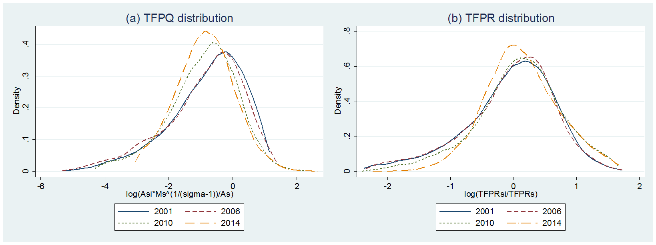
Dispersion of productivity and wedges
Distribution of
TFPQ and TFPR
TFPQ distribution:
Skewed to the left, i.e. indicating that more farms are less productive than the average productivity in agriculture.
The granularity in productivity increases over time, as more farms become less productive than the average TFPQ, while the average increase.
TFPR:
Variation indicates the presence of misallocation
Wedges:
Land wedge has the highest dispersion

Slide 9
Dispersion of productivity and wedges
Physical productivity, TFPQ
Revenue productivity, TFPR
Wedges

Slide 10
Dispersion of productivity by farm size
Physical productivity, TFPQ
Revenue productivity, TFPR

Slide 11
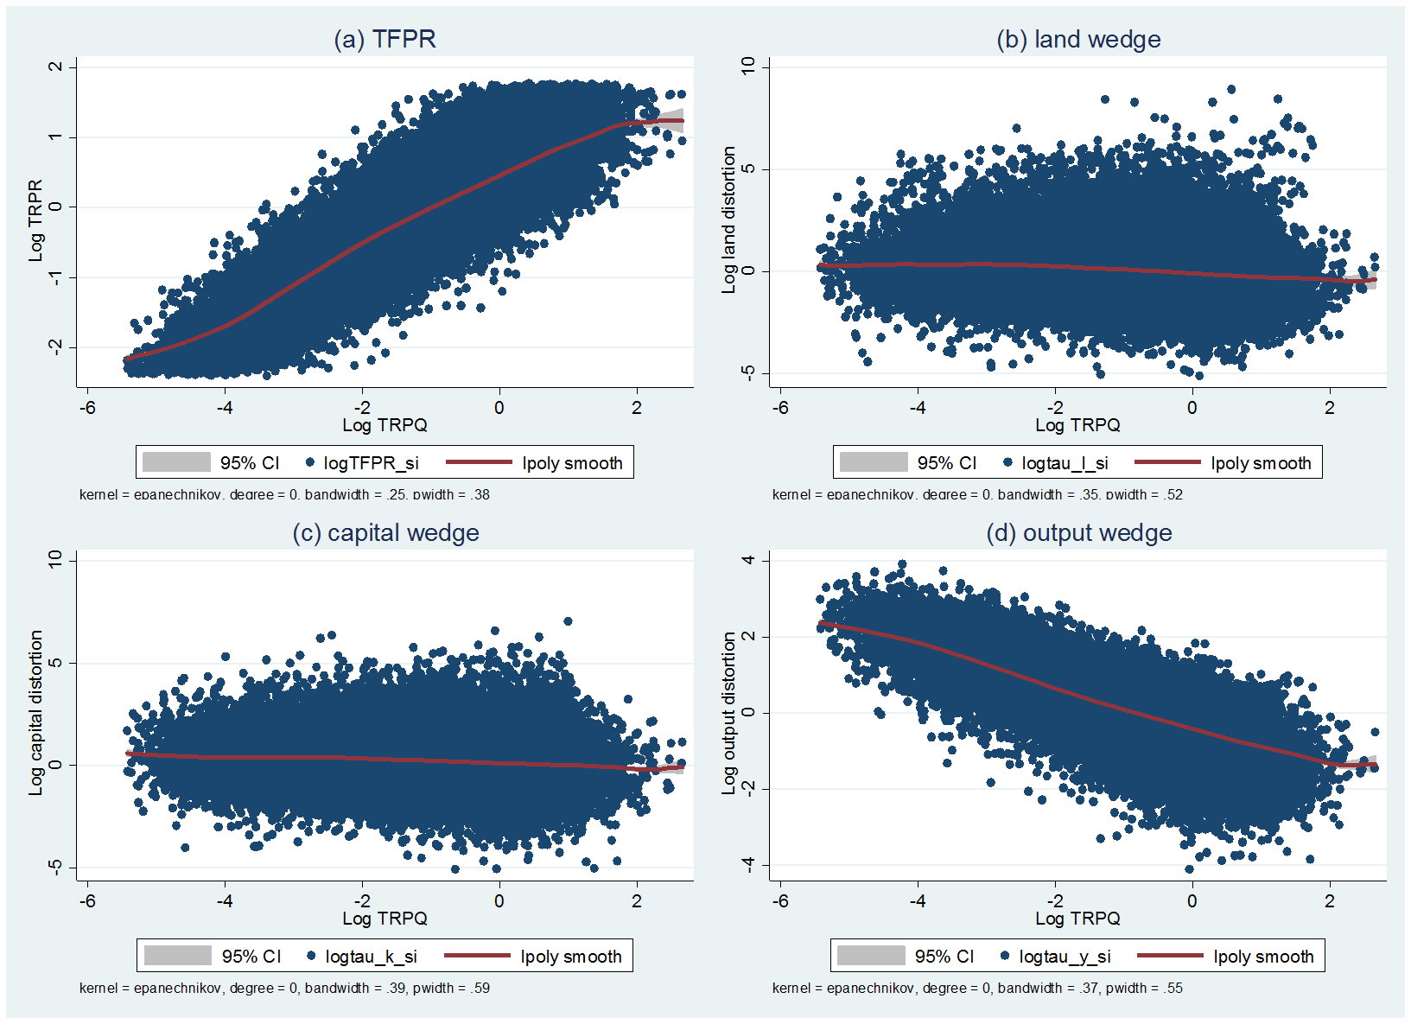
Distortions vs. productivity
A strong positive correlation between physical productivity TFPQ and revenue productivity TFPR (correlation 0.86).
The farms do not adjust their prices depending on productivity to equalize TFPR.
Land and capital wedge have a negative weak correlation with productivity of a farm (-0.18 and -0.12, respectively)
Strong negative correlation between output wedge and farm’s productivity (-0.77).
Current policies in agriculture mainly subsidize the least productive farms and tax the most productive ones.

Slide 12
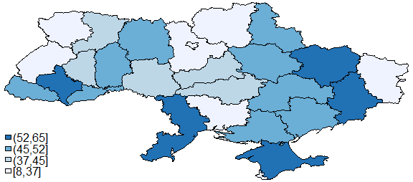
Productivity gains from efficient allocation
Productivity gains due to efficient allocation of resources
Productivity gains by farm size group, average in 2001-2014, %
Year | TFP gains from efficient allocation, %
 | Full | Within farm size | Within oblasts
2001 | 59.5 | 51.3 | 46.8
2002 | 61.0 | 51.1 | 47.1
2003 | 64.9 | 46.4 | 41.6
2004 | 55.0 | 36.2 | 33.3
2005 | 56.0 | 35.9 | 36.2
2006 | 60.1 | 41.9 | 27.7
2007 | 77.4 | 54.8 | 36.8
2008 | 83.5 | 63.7 | 47.7
2009 | 90.0 | 76.0 | 51.9
2010 | 82.7 | 70.6 | 47.0
2011 | 76.6 | 49.0 | 49.4
2012 | 90.2 | 59.5 | 57.9
2013 | 79.6 | 70.1 | 44.3
2014 | 80.6 | 63.5 | 51.5
Average | 71.9 | 55.0 | 44.2
Year | TFP gain within a farm size group, %
 | <500 | 500-1000 | 1000-2000 | 2000-3000 | >3000
Average in 2001-2014 | 73.30 | 65.92 | 60.49 | 55.41 | 50.55
Productivity gains by oblast, average in 2001-2014, %

Slide 13
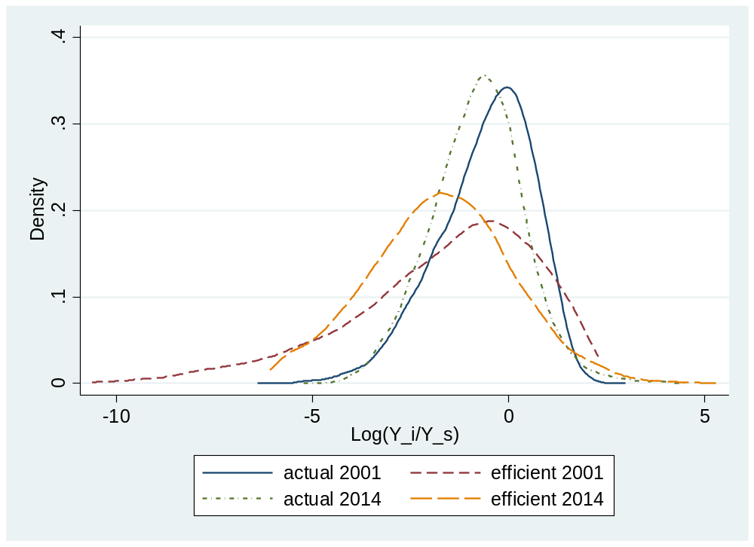
Actual vs efficient production
Actual vs. efficient distribution of production, %
Efficient vs actual farm size (by land area), % of total farms
2001 | 0-50 | 50-100 | 100-200 | >200
<500 ha | 5.1% | 1.4% | 0.9% | 0.8%
500-1000 ha | 11.2% | 3.3% | 2.1% | 1.7%
1000-2000 ha | 20.5% | 6.6% | 4.9% | 3.1%
2000-3000 ha | 10.0% | 4.7% | 3.3% | 1.8%
>3000 ha | 8.2% | 5.1% | 4.1% | 1.2%
# of firms | 5256 | 2019 | 1462 | 822
Share of firms | 55.0% | 21.1% | 15.3% | 8.6%
2014 | 0-50 | 50-100 | 100-200 | >200
<500 ha | 7.5% | 2.6% | 2.0% | 1.9%
500-1000 ha | 9.3% | 3.0% | 2.2% | 2.2%
1000-2000 ha | 18.9% | 6.3% | 3.2% | 2.8%
2000-3000 ha | 10.7% | 3.0% | 1.9% | 1.0%
>3000 ha | 13.8% | 3.7% | 2.2% | 1.9%
# of firms | 3570 | 1097 | 678 | 584
Share of firms | 60.2% | 18.5% | 11.4% | 9.8%
Efficient allocation tends to have wider left tail and higher dispersion
In the efficient allocation most of the farm should be downsized, i.e. the role of small farms in the aggregate agricultural value added should be higher

Slide 14
Robustness checks
Robustness checks, average in 2001-2014, % gains
Scenario | Sigma | Trim | Shares | Full | Within farm size | Within oblasts
Baseline | 5 | 2% | US | 71.9 | 55 | 44.2
Alternative 1 | 3 | 2% | US | 111.2 | 94.7 | 85.2
Alternative 2 | 3 | 1% | US | 86.9 | 77 | 64.1
Alternative 3 | 3 | 5% | US | 54.5 | 23.3 | 13.7
Alternative 4 | 3 | 2% | Ukraine | 68 | 50.7 | 39.2
Alternative 5 | 3 | 2% | China | 66.2 | 48.4 | 37.8
Higher sigma raise gains of full liberalization. This implies that we can consider our baseline results as the conservative ones.
Trimming 2% tails of outliers allows getting more consistent results as compared to trimming 1%, but less optimistic than trimming 5%.
The US factor shares used in the baseline calibration generate the highest gains as compared to the Ukrainian or Chinese factor shares.

Slide 15
Productivity and selection
Entry/exit versus productivity and factor wedges
Exiters are found to be the least productive, while incumbents are the most productive.
Increase in arable area by 1% results in 0.37% of physical productivity, while additional year of operation on average leads to 5.4% lower TFPQ.
No statistically significant difference in TFPR among exiters, entrants and incumbents.
Entrants face lower land wedge, higher capital wedge and higher output wedge, as compared to the incumbents
Exiters face lower land wedge and higher capital wedge, as compared to incumbents, but no significant difference in output distortion.
 | (1) | (2) | (3) | (4) | (5)
 | TFPQ | TFPR | 1+τ_{l} | 1+τ_{k} | 1-τ_{y}
Entrant | -0.063*** | 0.003 | -0.035** | 0.098*** | 0.026*
 | (0.014) | (0.010) | (0.012) | (0.012) | (0.011)
Exiter | -0.122*** | -0.005 | -0.074*** | 0.070*** | 0.017
 | (0.014) | (0.010) | (0.011) | (0.012) | (0.011)
Log land | 0.379*** | -0.022** | -0.135*** | -0.137*** | -0.051***
 | (0.011) | (0.008) | (0.010) | (0.010) | (0.009)
Age | -0.055*** | -0.015*** | 0.018*** | 0.032*** | 0.030***
 | (0.002) | (0.001) | (0.001) | (0.001) | (0.001)
Intercept | -3.468*** | 0.245 | 0.994*** | 1.433*** | 0.450**
 | (0.211) | (0.148) | (0.176) | (0.178) | (0.168)
Year FE | Yes | Yes | Yes | Yes | Yes
Oblast FE | Yes | Yes | Yes | Yes | Yes
N | 80662 | 80662 | 80662 | 80662 | 80662
R² | 0.096 | 0.012 | 0.012 | 0.032 | 0.024
Note: Standard errors in parentheses, * p < 0.05, ** p < 0.01, *** p < 0.001. All the models are evaluated with fixed effects regressions. Dependent variables are logs of productivity/wedge measure divided by the industry mean. The estimated model is

Slide 16
Conclusions
Liberalization of the land market in addition to deregulation will improve the allocation of resources in agriculture, which will lead to higher productivity in agriculture.
We apply Dias et al (2016), which is extended version of Hsieh and Klenow (2009), to a rich panel data of Ukrainian commercial farms.
We found a high and persistent variation of revenue productivity indicating the presence of resource misallocation. A land wedge is found to have the highest variation.
Fully optimal allocation of resources, on average, can boost agricultural productivity by 71.9%. Optimal allocation within farm size groups can increase productivity by 55.0%, while eliminating distortions within oblasts can add 44.2% to current agricultural productivity.
Small farms are more distorted than the big ones.
We do not found clear patterns in a spatial distribution of productivity gains.
In an optimal distribution more small-size farmers should operate in Ukrainian agriculture.
We also found that entry and exit of farms in Ukrainian agriculture lead to positive selection in favor of more productive farms.

Slide 17
Thank you!

