Slide 1
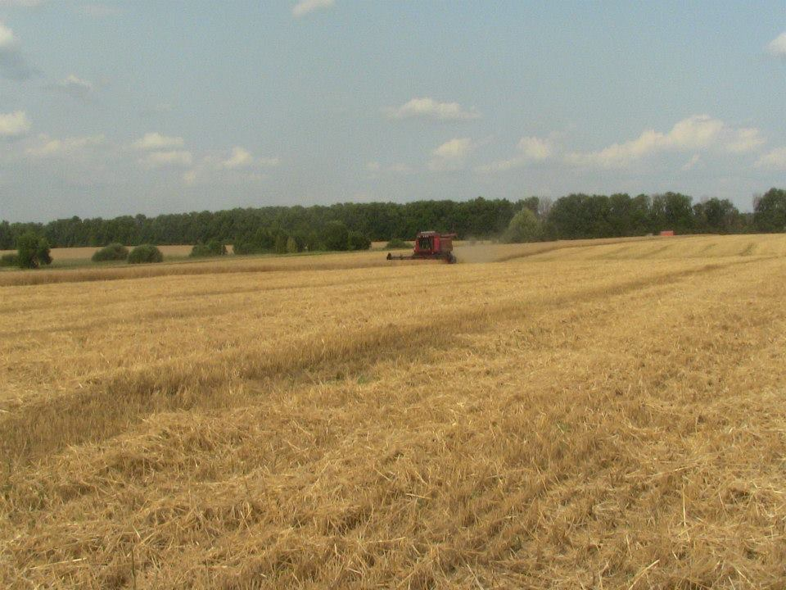
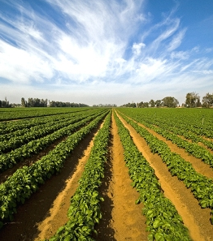

The Importance of Land Reform for Ukraine’s Social and Economic Development
Klaus Deininger, Nizalov Denys, Wael Zakout, Kathrine Kelm
World Bank, United States of America

Slide 2
Land Markets with big benefits – and risks
  Potential benefits are large
  Land holders: Increase in asset value & revenue
  Budget: Revenue from state land sale/rental & tax revenue
  Economy: Rural development & SME job growth
  But risks are significant
  Landlessness and social unrest
  Land raiding & unproductive concentration
  Entrenching corruption
  Lack of trust to the Government
  Population is opposing the market opening
  Population is not aware of their land right
1

Slide 3
Ensuring sustainability and procedural safeguards
  Transparency
  E-auctions and e-services
  Land management plans at rayon/hromada level
  Independent land governance monitoring
  Information campaign
  Sustainability & local growth
  Re-investment of revenue from state & communal land
      Inventory, registration & error correction
      Preparing new land plots for auction
      Community boundary registration
    Responsibility and conflict resolution (Land ombudsman)
  Scope for wide political support

Slide 4
Capacity Developmen for Evidence-Based Land & Agricultural Policy Making in Ukraine Project
Stared in 2015:
Infrastructure for transparency and accountability of land decision making:
Monitoring of Land Governance
Remote sensing of agricultural land use
Supporting policy dialog

Slide 5
Monitoring of Land Governance
A system for collecting, processing and publishing data on the state of land governance at regionally disaggregated level.
6 functional areas of land governance + Land Reform (country specific)
140 indicators for universe of 490 rayons and 182 cities
Based on administrative data
Compliant with FAO VGGT
Effective institutional arrangement
Pilot Implementation – April-December 2015

Slide 6






Sources of Administrative Data
StateGeoCadastre
(SE Center for State Land Cadastre)
State Fiscal Service
Ministry of Justice
(State Registry of Rights)
State Court Administration
State Statistics
State Water Agency
Automated Monitoring System

Slide 7
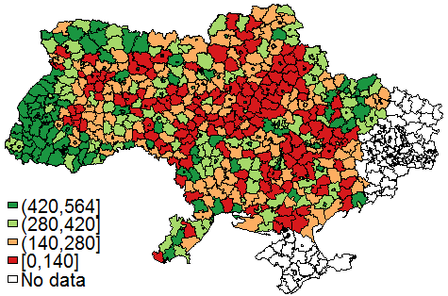
Monitoring for Policy Decision Making: Land Governance Index
1. Share of land registered in the Land Cadaster (private and state separately);
2. Transactions per 1,000 landowners (separately rental and other: sales, gifts, exchange, inheritance);
3. Land tax declarations per 1,000 of private land owners;
4. Number of land related disputes in court per 10,000 landowners (separately for administrative and civil)
Map: Index of Land Governance
(1 is the top rank)
Information on temporary occupied territory of AR Crimea and the conflict zone of Luhansk and Donetsk regions is not available

Slide 8
Implications and Challenges: next steps
Results so far:
Next steps:
Institutional arrangement is made
Collaboration among the stakeholders is established and tested
Base-line data is collected and published on the Project web site (land.kse.org.ua)
Cabinet of Ministers Resolution on Monitoring is developed and submitted to CMU
Sustain the Monitoring system
  Methodology
  Reporting software
Develop capacity to use evidence for reform design & keeping track
  Analytical papers & public debate
  Data updates on monitoring web-site
Help address broader policy constraints & document impact of doing so

Slide 9
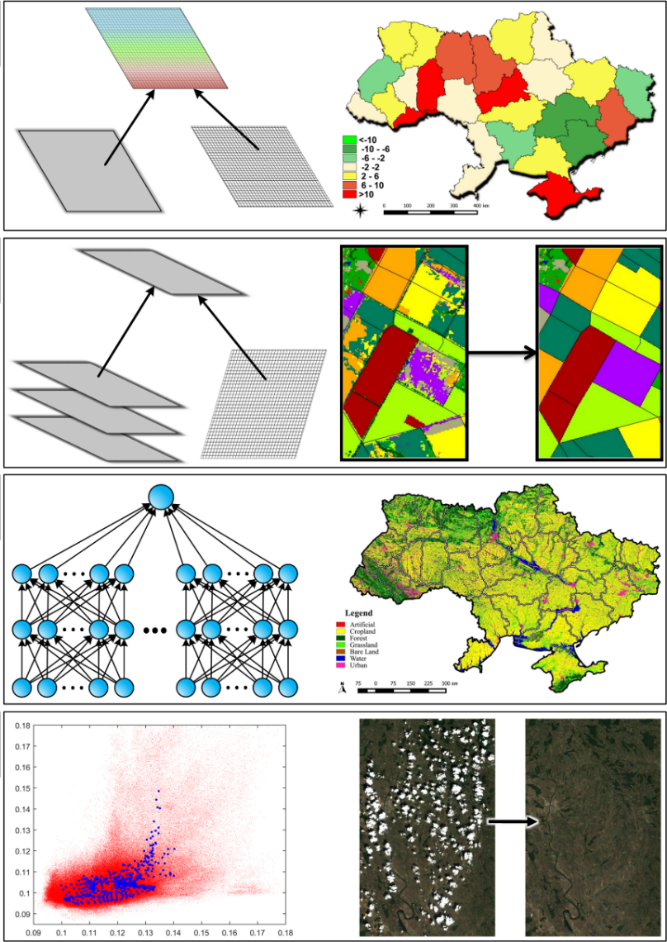
Remote sensing – new sources of information for decision making
Up to date information on the land use
Information for planning
Identification of:
  non-registered use
  non-authorized use of state and communal land
  non-authorized use of protected areas
Identification of scope for registration, error-correction and other improvements in the Cadaster and Registry of Rights

Slide 10
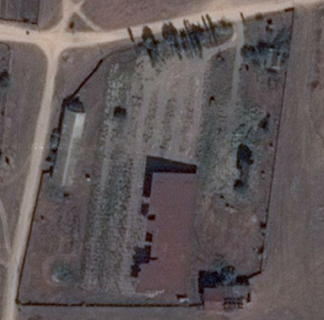
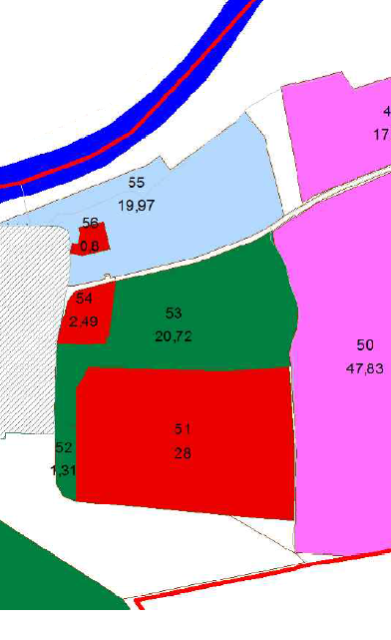
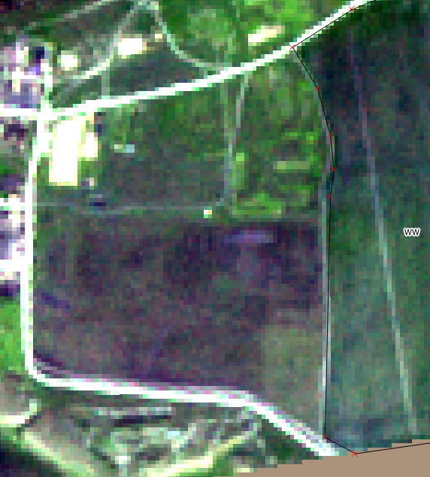
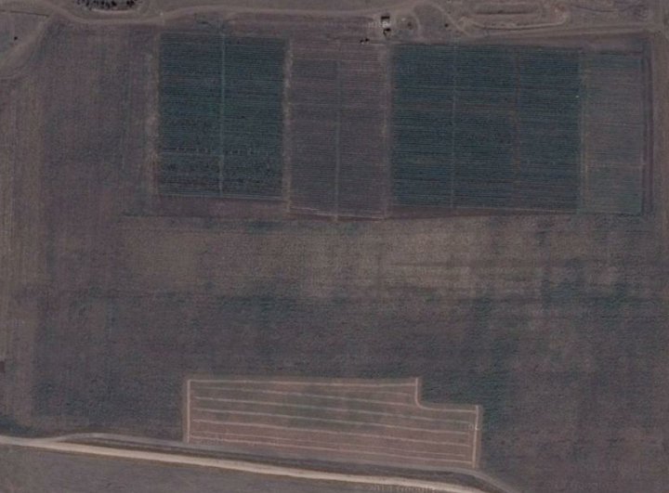
Use of non-registered land
9

Slide 11
Land Reform Road Map
Improve protection of rights of land owners and land users.
Enhance transferability and provide for efficient allocation of land resources.
Provide for transparency of land governance, preventing corruption.
Provide for sustainable land use and development of rural areas.
Access to finance and cross-sectoral issues.

